Slide 1
Welcome to SSIP Hackathon
Problem Statement : QR Code Based Citizen Feedback System For Gujrat Police

Slide 2
What is this problem about ?
There are many difficulties while collecting feedbacks in Police Department. There are no facilities available to collect feedback online and review it automatically.
Our system will help for collecting the feedback from citizen.
Also Admin(Police) will login through website and check the feedbacks of area.

Slide 3
Citizen Log in
By scanning QR code of particular area , citizen can give feedback for police department where he/she belongs to.
After scanning, citizen have to log in with their E-mail ID. So we can keep the record of it.
Our website will provide 3 types of feedback. This feedback will stored in our system.

Slide 4
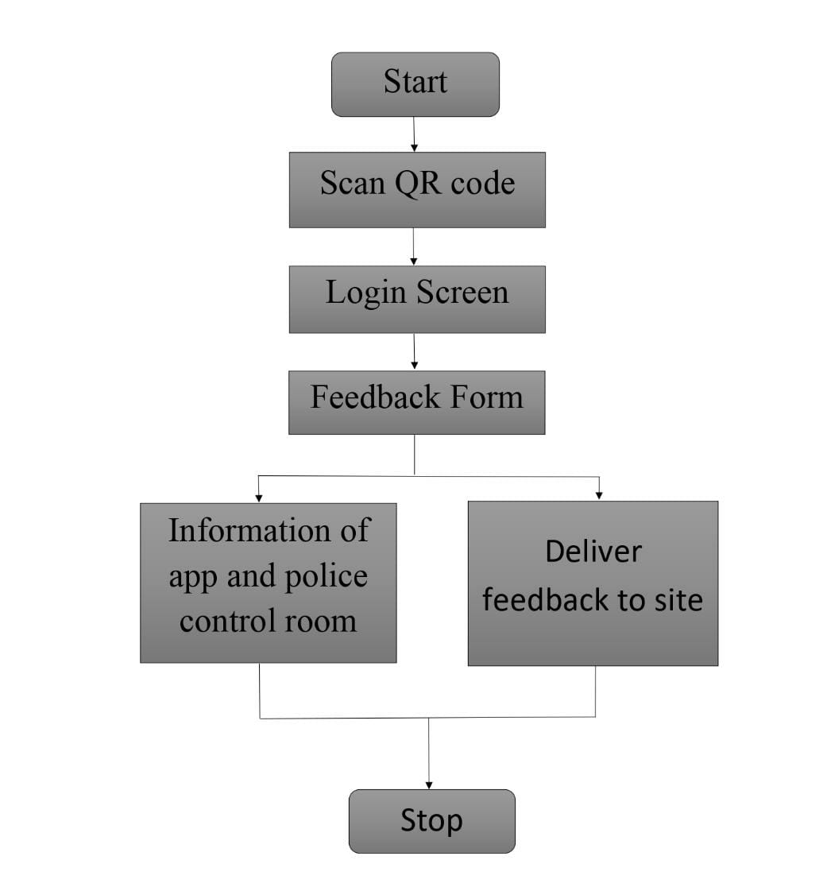
After scanning

Slide 5
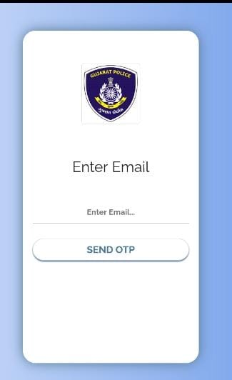
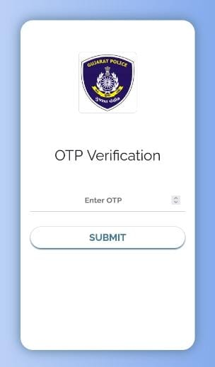
Citizen Pages

Slide 6
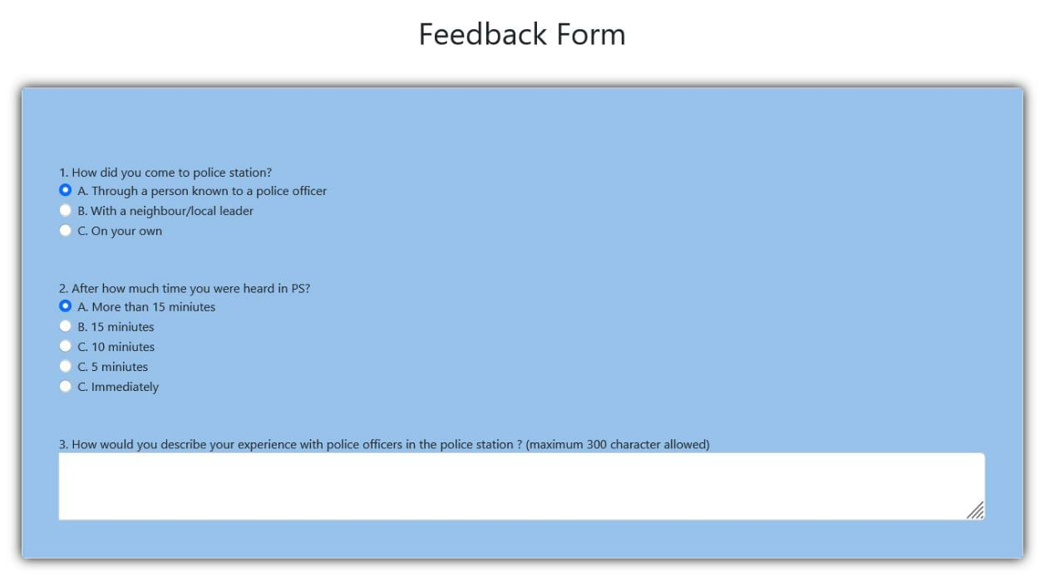
Feedback Form

Slide 7
Admin Log in
Admin (Police) can log in with their ID who has already registered.
1
Admin can generate QR code for police department.
2
Admin can check feedback which are given by citizen and improve their work by analysis it.

Slide 8
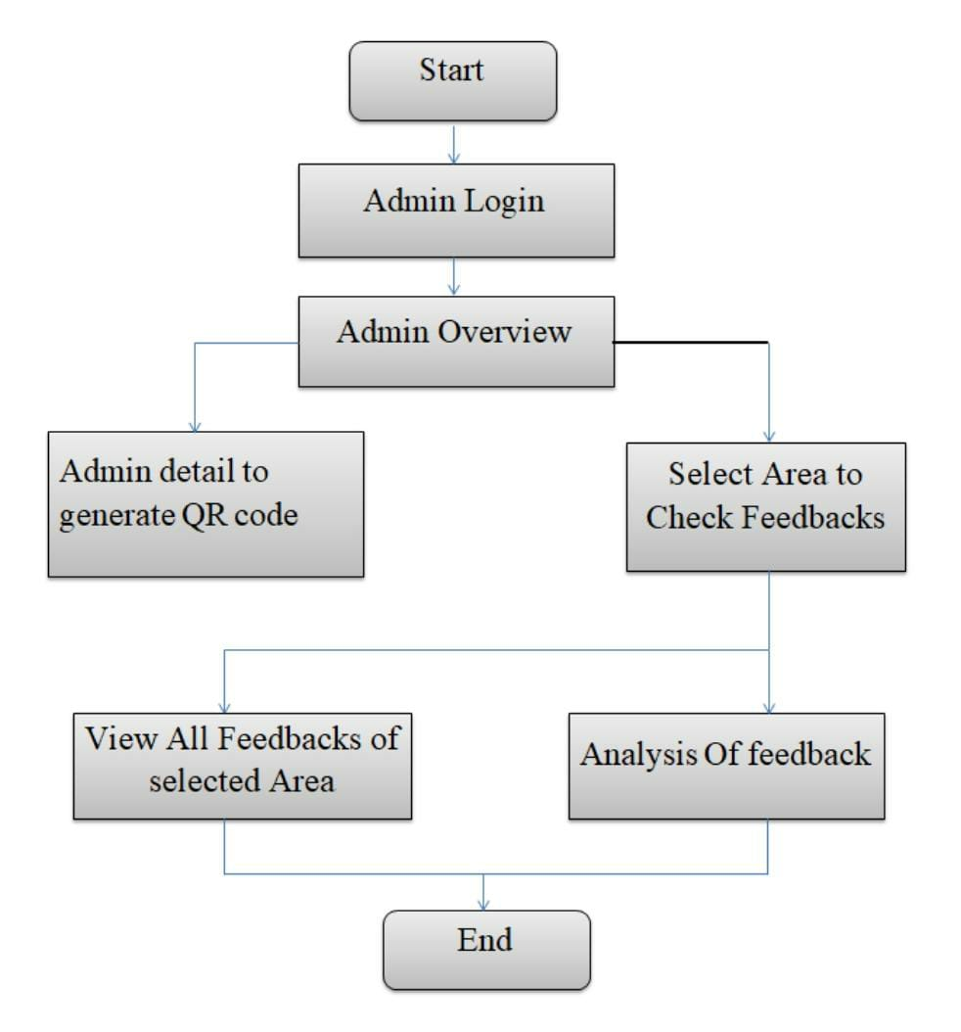
After Admin Log in

Slide 9
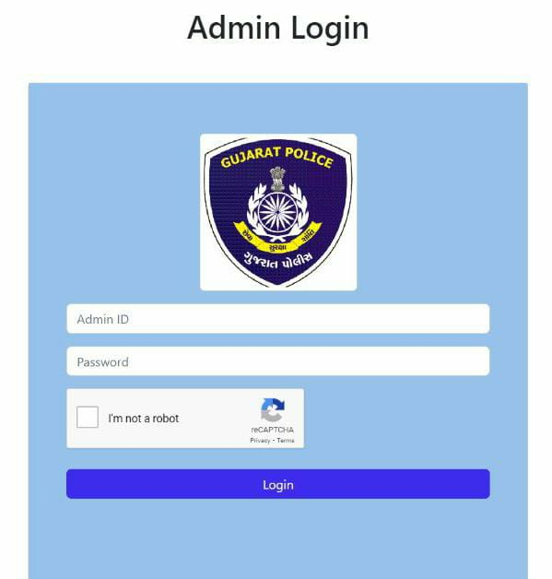
Admin Log in page

Slide 10
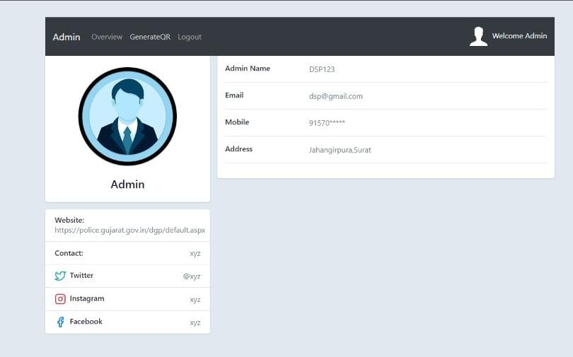
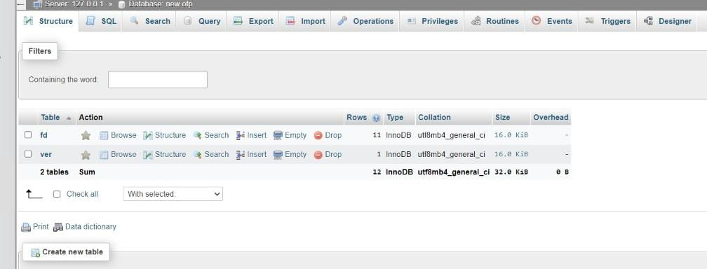
Admin Overview

Slide 11

Presented by
Patel Nishantkumar Sureshbhai
Patel Mihir Sureshbhai
Gohel Uday Aniruddhbhai
Lad Shivam Vinodbhai
Nirmal Harsh Janakbhai
Brahmaniya Fenil Girishbhai
2nd year students of Information Technology Department of Vishwakarma Government Engineering College, Chandkheda, Ahmedabad.

